Slide 1
Best Practices with Enterprise Library

Slide 2
Introductions
Toi B Wright (toi@onestopdesigns.com)
  President , Dallas ASP.Net User Group
  Microsoft MVP ASP.NET
  Microsoft Developer’s Guidance Council
  Organizer, WE ARE MICROSOFT – Charity Challenge Weekend
  President, Geeks in Pink

Slide 3
Welcome
The purpose of this user group is to help developers learn ASP.NET.
  My intent is to provide a forum for you to learn about and discuss the various components of a production quality ASP.NET application.
www.dallasasp.net

Slide 4
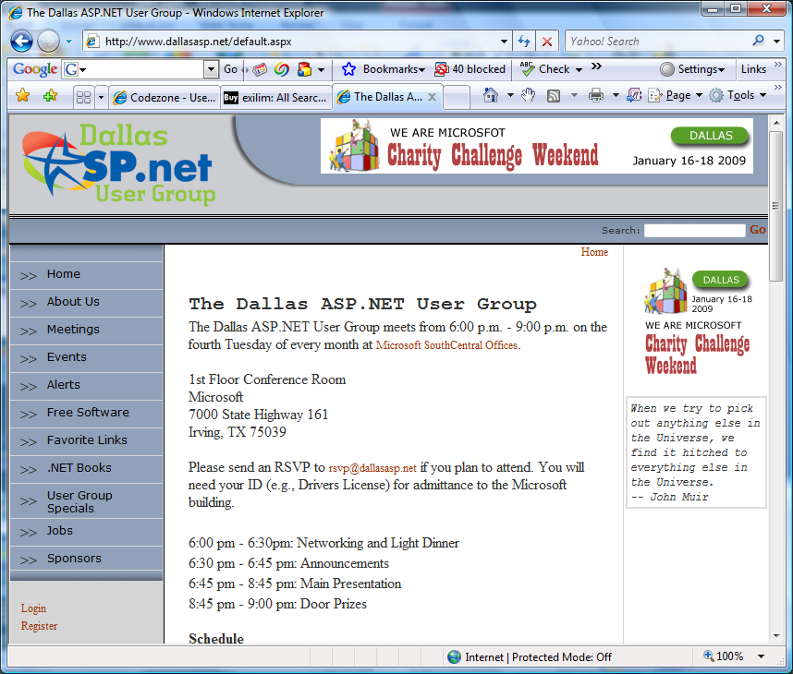
Our Website

Slide 5
Agenda
User Group Business
Announcements
Main Presentation
Door Prizes

Slide 6
User Group Business

Slide 7
Paperwork
Door Prizes
Dues
Renewal / Joiner Gift
RSVP by Noon
Notes:
LinkedIn

Slide 8

Upcoming Meetings
Sept 22
  Windows Communication Foundation (WCF)
  Stephen Fulcher
October 27
  Silverlight 3 for Business Applications –
  Jason Beres
November 24
  LINQ
  INETA Speaker ??
December 22 – No Meeting
Notes:
8

Slide 9
Upcoming Meetings
January 26, 2010
  Consulting Roundtable
February 23, 2010
  Entity Framework
March 23, 2010
  Visual Studio 2010
  Chris Koenig
Notes:
9

Slide 10

Later Tonight
Chili’s Grill & Bar
1300 Market Place Blvd
Irving, TX 75063-7229
214-574-4574
  Turn RIGHT onto access road 0.96 mo
  Turn LEFT onto N MACARTHUR BLVD. 0.86 mi
  Turn LEFT onto access road I-635 W/W LBJ FWY. 0.62 mi
  Restaurant is on RIGHT
Notes:
10

Slide 11
Announcements

Slide 12
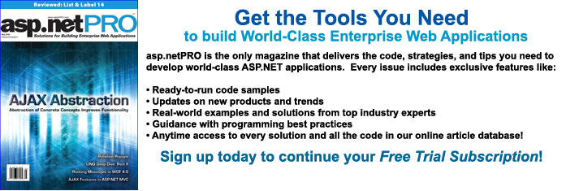
asp.netPRO
Magazine
FREE asp.netPRO – Print Subscription
3 Year/36 Issues
www.tinyurl.com/KeepMyASPNETPRO

Slide 13
DevCares
Amir Rajan
Silverlight and MVVM Crash Course
TekFocus, Friday, August 28
8:30 a.m. – 11:30 a.m.
So what's the big deal with the Model-View-View-Model (MVVM) design pattern? How does it differ from the Model-View-Controller (MVC) and Model-View-Presenter (MVP) design patterns? How can I leverage this pattern in Silverlight? The answers to your questions are here.
http://www.dallasdevcares.com/

Slide 14
Geeks in Pink
Networking Event
Tuesday, September 15
BlackFinn American Saloon
5 p.m. – 8 p.m.
4440 Belt Line Rd.
Addison, Texas 75001
http://blackfinndallas.com/addison/
Notes:
They will have drink specials from 4-7 and can extend that for our group until 8 PM. She said the most expensive drinks would be around $2.50.
We are planning on doing some networking exercises starting at 6PM.

Slide 15
Windows 7 Launch
Northpark Center 15
November 4, 8 a.m. – 5 p.m.
Get your FREE copy of Windows 7 at the event.
Tracks:
  Windows 7
  Windows Server 2008 R2
  Exchange Server 2010
www.microsoft.com/business/
thenewefficiency
2/24/2009
Notes:
15

Slide 16
WAM – Charity Challenge Weekend
BravoTECH
January 15-17, 2010
The We Are Microsoft - Charity Challenge Weekend is a software development competition for a good cause.
This 3-day event matches developers with charities to develop applications for those charities. At the end of the 3 days, all of the participants will vote and the winners will be proclaimed champion coders.
www.wearemicrosoft.com
2/24/2009
Notes:
16

Slide 17
Microsoft BizSpark
BizSpark is designed to give startups access to the tools, support and visibility they need, when they need it the most.
  Support
  Software
  Visibility
http://www.microsoft.com/BizSpark
Notes:
Software. Receive fast and easy access to current full-featured Microsoft development tools, platform technologies, and production licenses.
Support. Each of your developers will get access to a MSDN Premium subscription. You'll also get connected a global community of technical and business development experts.
Visibility. Achieve global visibility to an audience of potential investors, clients and partners.
There are no upfront fees for BizSpark access, enrollment or registration services, just a $100 Program Fee upon program exit.

Slide 18
Microsoft BizSpark Requirements
Your Business →
  Is in the business of software development
  Is privately held
  Has been in business for less than 3 years
  Has less than US $1 million in annual revenue
  Is sponsored by a BizSpark Network Partner
  http://www.microsoft.com/BizSpark
Notes:
To enroll, you must be sponsored by a BizSpark Network Partner. Find a BizSpark Network Partner.
To be eligible to use the software for production and deployment of hosted solutions Startups must also be developing a new “software as a service” solution (on any platform) to be delivered over the Internet.

Slide 19
Ramp Up
Ramp Up is a free, online, community-based learning program, with a number of different tracks that will help you build your portfolio of professional development skills.
http://msdn.microsoft.com/rampup

Slide 20
Best Practices with Enterprise Library

Slide 21
Definition
Enterprise Library is a collection of application blocks and services intended for use by developers who build complex, enterprise-level applications.
Their design encapsulates the Microsoft recommended best practices for .NET applications
Notes:
Originally designed for .NET Framework 1.1. First released in January 2005

Slide 22
Enterprise Library
Enterprise Library is…
A library of application blocks which solve common challenges
A set of helper classes which work in any architectural style
Architectural guidance embodied in code which ships with full source allowing you to modify and extend
Available as a free download
Enterprise Library is not…
A part of the .NET Framework
An application framework that imposes an architectural style
A Microsoft product with support, compatibility and localization
For sale

Slide 23
Goals
Consistency
  All Enterprise Library application blocks feature consistent design patterns and implementation approaches.
Extensibility
  All application blocks include defined extensibility points that allow developers to customize the behavior of the application blocks by adding their own code.
Ease of use.
  Enterprise Library offers numerous usability improvements, including a graphical configuration tool, a simpler installation procedure, and clearer and more complete documentation and samples.
Integration.
  Enterprise Library application blocks are designed to work well together and are tested to make sure that they do. It is also possible to use the application blocks individually.

Slide 24
Application Blocks
Caching Application Block. Developers can use this application block to incorporate a local cache in their applications.
Cryptography Application Block. Developers can use this application block to incorporate hashing and symmetric encryption in their applications.
Data Access Application Block. Developers can use this application block to incorporate standard database functionality in their applications.

Slide 25
Application Blocks
Exception Handling Application Block. Developers and policy makers can use this application block to create a consistent strategy for processing exceptions that occur throughout the architectural layers of enterprise applications.
Logging Application Block. Developers can use this application block to include standard logging functionality in their applications.
The Policy Injection Application Block. Developers can use this application block to implement interception policies that streamline the implementation of common features, such as logging, caching, exception handling, and validation, across an application.

Slide 26
Application Blocks
Security Application Block. Developers can use this application block to incorporate authorization and security caching functionality in their applications.
Unity Application Block. Developers can use this application block to implement a lightweight, extensible dependency injection container with support for constructor, property, and method call injection.
The Validation Application Block. Developers can use this application block to create validation rules for business objects that can be used across different layers of their applications.

Slide 27
Core
Common Assembly
Instrumentation
Configuration Helper Classes
Microsoft.Practices.EnterpriseLibrary.Common.dll
Microsoft.Practices.ObjectBuilder2.dll
Notes:
In addition, all the application blocks are designed to have a limited number of dependencies so that they can be used individually as well as with other application blocks. All application blocks except the Unity Application Block depend on the Enterprise Library Core, which is a logical grouping made up of the following subsystems:
The Common assembly
Instrumentation for the application blocks
Configuration helper classes and design-time configuration components
For information about the dependencies between application blocks and the Enterprise Library Core, see Application Block Dependencies.
The Common Assembly
The Enterprise Library includes an assembly named Common that contains useful elements that are shared among multiple application blocks. Any application that uses an Enterprise Library application block (with the exception of the Unity Application Block) must reference this assembly. By supplying a set of commonly used functions to all the application blocks, the Common assembly reduces the dependency of one application block on another.
The following are some criteria used to factor elements into the Common assembly:
Elements could not depend on other application blocks. However, they could depend on other elements that are already in the Common assembly.
Elements could not depend on any persistent state.
Elements could not depend on any third-party technology.
Elements could not imply a particular application model. They could be used equally well in any application model. For example, the elements should function as well in a smart client as in a Web service.
Instrumentation
Most of the application blocks contain instrumentation. The types of instrumentation are the following:
Performance counters
Event log events
WMI (Windows Management Instrumentation) events
The instrumentation classes are a part of the Enterprise Library Core and are located in the Common assembly. You can reuse this code in your own applications.
By default, instrumentation is disabled, but you can use the Enterprise Library configuration tools to enable each type of instrumentation. If you have administrative rights, you can use the Installutil.exe program to install the instrumentation.
Most other dependencies are encapsulated in individual providers. For example, the Exception Handling Application Block can use the Logging Application Block to publish exception information, but this is not a requirement. You can choose to publish exception information to other sources, such as the event log, or you can extend the Exception Handling Application Block by supplying your own logging provider.
Configuration Helper Classes and Design-time Components
Configuration uses the System.Configuration namespace, which makes it easier to use application blocks either with configuration files or without them. Factories (and the Unity Application Block) create application block objects from the data contained in configuration files. It is possible to use alternatives to XML configuration files as configuration sources. For example, you can use a SQL Server database. You can also create objects without using configuration files; you can do this by using constructors with primitive data types.
To support extensibility in Enterprise Library, configuration includes helper classes in addition to those classes found in the System.Configuration namespace. These helper classes support polymorphic collections, generic collections, and configuration sources. These enhancements require configuration to be based on the Dependency Injection pattern instead of the Provider pattern, as is the case with the System.Configuration namespace.
The configuration tools allow you to change an application block's configuration without directly editing the XML configuration files. You can use the design-time components that the configuration tools use with applications and application blocks that you create to give your users a similar experience to the Enterprise Library Configuration Console and Configuration Editor.
Enterprise Library contains a set of core features that integrate the application blocks with the configuration system, support alternative configuration systems, and provide common utilities and routines used across all of the application blocks. The following are some examples of the contents of the Enterprise Library core:
Design-time configuration classes that support the configuration tools and allow developers to specify and persist configuration information for the library and the application blocks
Run-time configuration classes and providers that expose configuration data to the library, the application blocks, and users' applications at run time
Common utility functions for tasks such as serialization, used in many places throughout the library and the application blocks and available for developers to use in their code
Instrumentation features that allow developers and administrators to monitor the behavior and performance of the application blocks at run time

Slide 28
Application Blocks
Caching
Data
Access
Logging
Core
Config
Helpers
& Design
Instrumen-
tation
Cryptography
Exception
Handling
Object
Builder
Security
Policy Injection
Validation
Notes:
28
First up is the configuration application block and configuration tool.

Slide 29
Client App
Caching
Data Access
Logging
Core
Config
Helpers
& Design
Plug-in
Instrumen-
tation
Cryptography
Exception
Handling
Object
Builder
Security
Policy Injection
Validation
Notes:
29

Slide 30
Client App
Unity DI
Unity Extensions
Data Access
Caching
Logging
Core
Config
Helpers
& Design
Plug-in
Instrumen-
tation
Cryptography
Exception
Handling
Object
Builder2
Security
Policy Injection
Validation
Unity Dependency Injection Container
Notes:
Unity Dependency Injection Container
30

Slide 31
Benefits
Testability
  Injecting objects instead of calling static methods means you can mock them out
Uniformity
  You always get access to the blocks the same way
Extensibility
  Your own services can be put into the container too
  Easier to write blocks – container handles the config
Flexibility
  Container-friendly design means you can switch containers if you need/want to
Notes:
31

Slide 32
Quick Details
Enterprise Library 4.1 - October 2008.msi
Version: 4.1
Date Published: 10/27/2008
Language: English
Download Size: 30.7 MB
http://msdn.microsoft.com/entlib
Notes:
In general, applications built for Enterprise Library for .NET Framework 2.0 – January 2006 and later will function with this release of Enterprise Library, without the need for any code changes. It will be necessary to update the references to refer to the new assemblies and to update the configuration files to reference the correct version of the assemblies.
This version of Enterprise Library can also be installed side-by-side with earlier versions of Enterprise Library. You can deploy new applications written for this version of Enterprise Library along with applications written for earlier versions. In addition, you can choose to migrate existing applications, one assembly at a time, to the new version.
If you decide to use side-by-side execution, you must deploy the different Enterprise Library versions in different directories. In any specific directory, you cannot mix and match assemblies from different versions. For example, you cannot have Data Access Application Block version 4.0 in the same directory with Caching Application Block version 3.0.

Slide 33
System Requirements
Microsoft Windows XP Professional, Windows Server 2003, Windows Server 2008, or Windows Vista operating system
Microsoft .NET Framework 3.5 or later
Microsoft Visual Studio 2008 development system (any of the following editions):
  Microsoft Visual Studio 2005 Standard Edition
  Microsoft Visual Studio 2005 Professional Edition
  Microsoft Visual Studio 2005 Team Edition for Software Development
  Microsoft Visual Studio 2005 Team Edition for Software Testers
  Microsoft Visual Studio 2005 Team Edition for Software Architects
  Microsoft Visual Studio 2005 Team Suite
Some blocks and samples require the use of Microsoft SQL Server or other database products.
Notes:
For all application blocks except for the Unity Application Block, the Enterprise Library core features, and the configuration tools, the minimum requirements are:
Microsoft Windows XP Professional, Windows Server 2003, Windows Server 2008, or Windows Vista operating system
Microsoft .NET Framework 3.5 or later
Microsoft Visual Studio 2008 development system (any of the following editions):
Standard Edition
Professional Edition
Team Edition for Software Developers
Team Edition for Software Testers
Team Edition for Software Architects
Team Suite
Note:The Unity Application Block is a general-purpose dependency injection mechanism designed for use in applications that run on the .NET Framework 2.0 and later. It is not limited to use only within Enterprise Library. For details of the system requirements and development software requirements for the Unity Application Block, see System Requirements for the Unity Application Block.
To run the Unit Tests, the following is also required:
Visual Studio 2008 Professional or Visual Studio 2008 Team Edition. Enterprise Library includes both unit test binaries and source code. You need a version of Visual Studio that supports unit tests. For instructions about how to use the unit tests, see Unit Tests. If you modify the unit test source, you will need to recompile it, which also requires Visual Studio 2008 Professional or Visual Studio 2008 Team Edition.
For the Data Access Application Block, the following is also required:
A database server running a database that is supported by a .NET Framework 3.5 data provider. This includes SQL Server 2000 or later, SQL Server 2005 Compact Edition, and Oracle 9i or later. The database server can also run a database that is supported by the .NET Framework 3.5 data providers for OLE DB or ODBC.
For the Logging Application Block, the following is also required:
Stores to maintain log messages. If you are using the MsmqTraceListener trace listener to store log messages, you need a message queue. If you are using the DatabaseTraceListener trace listener to store log messages, you need a database server. If you are using the EmailTraceListener trace listener to store log messages, you need an SMTP server.

Slide 34
Contents
Source Code
Unit Tests
Quick Starts
Documentation
Binaries - NEW
Notes:
This release of Enterprise Library contains the following:
Binaries. The Enterprise Library includes pre-compiled, strong-named assemblies for all the source code. For more information, see Using the Signed Binary Assemblies.
Source code. The Enterprise Library includes the source code for the application blocks, the configuration tools, the unit tests, and the QuickStarts.
Unit tests. The Enterprise Library includes the unit tests that were created while the application blocks were being developed. For more information, see Unit Tests.
QuickStarts. Enterprise Library QuickStarts are brief, easy-to-understand illustrations of key application block features. Each application block includes one or more QuickStart.
Documentation. Enterprise Library includes documentation that can be viewed with the Visual Studio Help system. The documentation includes guidance about how to use the Enterprise Library and a class library reference.

Slide 35
Caching Application Block
scenarios …
Adding items to the cache
Removing items from the cache
Retrieving items from the cache
Flushing the cache
Notes:
This section describes the most common situations developers must address when storing data in a cache. Each scenario explains the task, gives a real-world situation for the task, and includes code demonstrating how to use the Caching Application Block to complete the task. The scenarios are divided into two sections. The first section demonstrates the basic caching operations:
Adding Items to the Cache. This topic describes how to add an item to the cache using the Add method. It also lets you set the item's expiration policy (for the expiration process) and its priority (for the scavenging process).
Removing Items from the Cache. This topic describes how to remove an item from the cache using the Remove method.
Retrieving Items from the Cache. This topic describes how to obtain an item from the cache using the GetData method.
Flushing the Cache. This topic describes how to flush the cache, which empties it, using the Flush method.

Slide 36
Caching Application Block
brief …
  The caching block is not designed to replace the ASP.NET cache but to work with it. The caching block provides a number of features that are not available to the ASP.NET cache such as:
    The ability to use a persistent backing store
    Multiple methods of setting expiration times
    Can be used for project types other than web applications
    The core settings are described in configuration and can be changed without recompilation of the project.
    Ability to encrypt a cache item's data
  You cannot synchronize caching across a web farm
  Does not support encryption of data that is cached in memory
Notes:
The Caching Application Block works with ASP.NET cache and provides a number of features that are not available to the ASP.NET cache such as:
The ability to use a persistent backing store - both isolated storage and database backing store
The ability to encrypt a cache item's data - this works only when using a persistent backing store
Multiple methods of setting expiration times - absolute time, sliding time, extended time format, file dependency, or never expires
The core settings are described in configuration files and can be changed without recompilation of the project
Can be extended to create your own expiration policies and storage mechanisms

Slide 37
Caching Application Block
ICacheManager productsCache = CacheFactory.GetCacheManager();
string id = "ProductOneId";
string name = "ProductXYName";
int price = 50;
Product product = new Product(id, name, price);
productsCache.Add(product.ProductID, product, CacheItemPriority.Normal, null, new SlidingTime(TimeSpan.FromMinutes(5)));
// Retrieve the item.
product = (Product) productsCache.GetData(id);

Slide 38
DEMO

Slide 39
Cryptography Application Block
scenarios …
Encrypting data using a symmetric provider
Decrypting data using a symmetric provider
Obtaining a has value
Checking whether a hash value matches some text
Notes:
This topic describes the most common situations that developers must address when providing cryptography functionality in their applications. Each scenario explains the task, describes a real-world situation where such a task might occur, and includes code that demonstrates how to use the Cryptography Application Block to complete the task. The scenarios are the following:
Encrypting Data Using a Symmetric Provider. This scenario illustrates how you can use a symmetric algorithm provider to encrypt a secret.
Decrypting Data Using a Symmetric Provider. This scenario illustrates how you can use a symmetric algorithm provider to decrypt a secret that has been encrypted.
Obtaining a Hash Value. This scenario illustrates how you can generate a hash value from data.
Checking Whether a Hash Value Matches Some Text. This scenario illustrates how you can compare plaintext data with a hash value previously generated from the data. By doing this, you can verify that the data has not been changed since the hash was originally generated.

Slide 40
Cryptography Application Block
brief …
Managing and Distributing Keys
  Symmetric encryption encrypts and decrypts data with the same key.
  Protect your keys with access control lists (ACL).
Selecting an Algorithm
  For hashing algorithms, SHA256Managed is recommended
  For symmetric algorithms, AES, also known as Rijndael, is recommended
Notes:
Managing and Distributing Keys
Symmetric encryption encrypts and decrypts data with the same key. Both the application that sends the data and the application that receives the data must possess this key. Any other application that can access this key can also decrypt the data that was encrypted with the key. This means that attackers can decrypt encrypted data if they can obtain the encryption key. Also, attackers can prevent you from reading your encrypted data by deleting or corrupting your key file. A key file is an encrypted text file that contains your keys. You must carefully manage your shared keys. Consider the following guidelines to help you protect your keys:
Protect your keys with access control lists (ACL). Only grant the necessary permissions to the identities that require access to the key file.
Do not configure your computer to allow remote debugging when that computer runs in a high-risk environment. An example of such a computer is a Web server that allows anonymous access.
Selecting an Algorithm
An encryption algorithm provides no security if the encryption algorithm is cracked or is vulnerable to brute force cracking. Custom algorithms are particularly vulnerable if they have not been tested. Instead, use published, well-known encryption algorithms that have withstood years of rigorous attacks and scrutiny.
Recommended key lengths change as computing power grows. Encryption key lengths that range from 128 bits to 256 bits are currently considered to be secure. Most modern algorithms use keys that are at least 128 bits long.
For hashing algorithms, the SHA256Managed algorithm is recommended. This algorithm uses a hash size of 256 bits. The hash size of SHA1Managed hashing algorithm is 160 bits. This algorithm is acceptable but not encouraged. The MD4 and MD5 algorithms are no longer recommended.
For symmetric algorithms, AES, also known as Rijndael, is recommended. This algorithm supports key lengths of 128, 192, 256 bits. The DES algorithm is not recommended.

Slide 41
Cryptography Application Block
string encryptedContentsBase64 = Cryptographer.EncryptSymmetric("symmProvider", "SensitiveData");
// Decrypt the base64 encoded string
string readableString;
readableString = Cryptographer.DecryptSymmetric("symmProvider", encryptedContentsBase64);

Slide 42
DEMO

Slide 43
Data Access Application Block
scenarios …
Using a DataReader to retrieve multiple rows of data
Using a DataSet to retrieve multiple rows of data
Executing a command and retrieving the output parameters
Executing a command and retrieving a single-value item
Performing multiple operations within a transaction
Retrieving XML data from a SQL Server
Updating a database with data contained in a DataSet object
Notes:
This topic describes the most common situations developers must address when accessing a database. Each scenario explains the task, describes a real-world situation where such a task might arise, and includes code demonstrating how to use the Data Access Application Block to complete the task. The scenarios are as follows:
Using a DbDataReader to Retrieve Multiple Rows. This scenario illustrates how you can use the ExecuteReader method to retrieve multiple rows of data from a database for display in tabulated form—without explicitly caching the data, using a DataSet object to manipulate it, or passing it to other components within your application. In other words, it illustrates how to display the results as quickly as possible.
Using a DataSet to Retrieve Multiple Rows. This scenario illustrates how you can use the ExecuteDataSet method to pass data between the components and the tiers of a multi-tier application. The data consists of one or more data tables and, optionally, the relationships that link the tables together.
Executing a Command and Accessing Output Parameters. This scenario illustrates how you can use the ExecuteNonQuery method to retrieve a single row that contains multiple column values.
Executing a Command and Accessing a Single-Item Result. This scenario illustrates how you can use the ExecuteScalar method to perform a single-item lookup.
Performing Multiple Updates Within a Transaction. This scenario illustrates how you can use the ExecuteNonQuery method from within a transaction to perform multiple operations against a database, where it is essential that either all operations succeed or none succeed.
Using a DataSet to Update a Database. This scenario illustrates how, after changing a DataSet object, you can use the UpdateDataSet method to update the database and make your changes permanent.
Retrieving Multiple Rows As XML. This scenario illustrates how you can use the ExecuteXmlReader method to retrieve data from a SQL Server and have that data returned in XML format.

Slide 44
Data Access Application Block
ExecuteDataSet
LoadDataSet
ExecuteReader
ExecuteScalar
ExecuteNonQuery
UpdateDataSet
Notes:
While the Database.ExecuteDataSet method fills a new DataSet with data, the Database.LoadDataSet method fills an existing DataSet.

Slide 45
Data Access Application Block
Database db = DatabaseFactory.CreateDatabase();
// Create a database object
DbCommand dbCommand = db.GetStoredProcCommand("GetProductsByCategory");
// Supply the parameters
db.AddInParameter(dbCommand, "CategoryID", DbType.Int32, 7);
// Call the appropriate method
DataSet productDataSet = db.ExecuteDataSet(dbCommand);
Notes:
Developers only need to do the following:
Create the database object.
Supply the parameters for the command, if they are needed.
Call the appropriate method(s). These methods are optimized for performance. They are also portable.

Slide 46
DEMO

Slide 47
Logging Application Block
scenarios …
Populating and raising events from code
Populating a log message with additional context information
Tracing activities and propagating context information
Checking filter status before constructing log messages
Notes:
Developers can use the Logging Block to write information to a variety of locations:
The event log, An e-mail message, A database, A message queue, A text file, Custom locations using application block extension points
Populating and Raising Events from Code. This scenario illustrates how to specify the data to be logged, along with a category and priority, and pass it to the application block.
Populating a Log Message with Additional Context Information. This scenario illustrates how to populate a dictionary of custom information to be added to a log entry.
Creating Custom Trace Listeners. This scenario illustrates how to create a custom trace listener for sending logging messages to an alternate location.
Checking Filter Status Before Constructing Log Messages. This scenario illustrates how to avoid collecting log information for messages that will not be logged according to the current configuration information.

Slide 48
Logging Application Block
LogEntry logEntry = new LogEntry();
logEntry.EventId = 100;
logEntry.Priority = 2;
logEntry.Message = "Informational message";
logEntry.Categories.Add("Trace");
logEntry.Categories.Add("UI Events");
Logger.Write(logEntry);

Slide 49
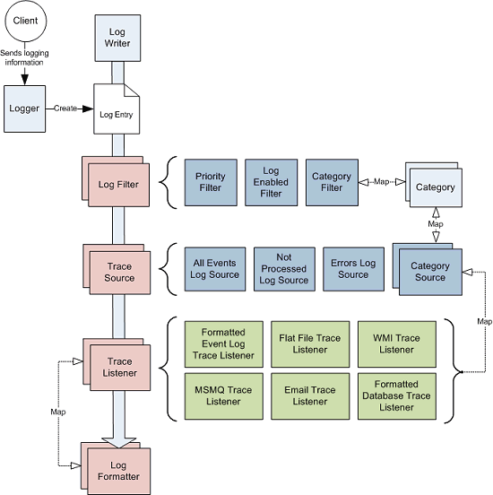
Processing of log entries in the Logging Application Block
Notes:
The Logging Process Sequence
Your application submits information that the application block should log either by using the Logger class to automatically create a log entry or by directly creating an instance of the LogEntry class and populating it with the information to log. The log entry can define a set of categories that map to the categories defined in the configuration. This mapping controls the processes that the block applies to the log entry (the filters and sources that it uses).
The log writer passes the log entry through the log filters that you define in the configuration. These filters can block the log entry based on its priority, category name, or when logging is not enabled.
If the log filters do not block the log entry, the log writer retrieves the appropriate trace sources. The trace sources you can use consist of a set of category sources that you create and configure, and three special sources that you can use to ensure the application block will record all log entries (for example, if there is an error within the logging system or if the log entry does not match any configured category).
You can configure one or more trace listeners for each of the trace sources. In other words, you can configure a specific set of trace listeners for each category that the message might contain, and for each of the three special sources that might handle the message. The log writer will pass the log entry to the matching trace listeners you specify.
The trace listener then uses a log formatter to transform the information in the log entry into an appropriate format, such as formatted text or binary, and writes the result to the output specific to the type of trace listener. Depending on the trace listener type, the output can go to a file, a database, WMI, Message Queuing (also known as MSMQ), or as an e-mail message.

Slide 50
DEMO

Slide 51
Exception Handling Application Block
scenarios …
Logging an Exception
Wrapping an Exception
Replacing an Exception
Propagating an Exception
Displaying User-Friendly Messages
Notifying the User
Notes:
Logging an Exception
Wrapping an Exception
Replacing an Exception
Propagating an Exception
Displaying User-Friendly Messages
Notifying the User
Assisting Support Staff
Shielding Exceptions at WCF Service Boundaries

Slide 52
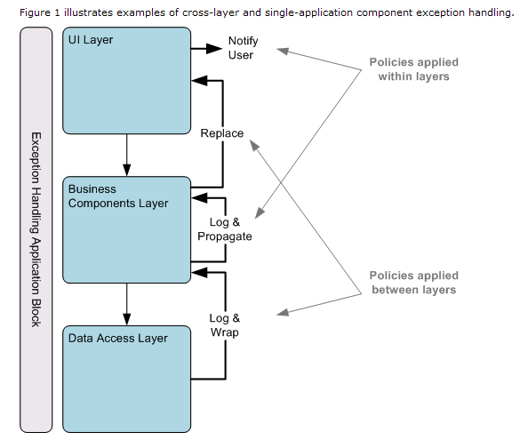
Exception Handling Application Block

Slide 53
Exception Handling Application Block
try
{
// Run code.
}
catch(Exception ex)
{
bool rethrow = ExceptionPolicy.HandleException(ex, “My Policy");
if (rethrow)
throw;
}

Slide 54
DEMO

Slide 55
Security Application Block
scenarios …
Obtaining a temporary token for an authenticated user
Authenticating a user using a token
Ending a user session (expire a token)
Determining if a user is authorized to perform a task
Notes:
Obtaining a Temporary Token for an Authenticated User. This scenario illustrates how to use the SaveIdentity method to cache an authenticated identity and return a temporary token that serves as an alternative to user credentials for the duration of the user session. You can also use this technique to save a user principal or a user identity.
Authenticating a User Using a Token. This scenario illustrates how to use the GetIdentity method to return an identity that has already been cached, when provided with a valid token. The same technique can be used to retrieve a user principal or user profile.
Terminating a User Session (Expiring a Token). This scenario illustrates how to use the ExpireIdentity method to expire a token corresponding to an identity, when the user session ends. You can also use this technique to expire a user principal or a user profile.
Determining Whether a User Is Authorized to Perform a Task. This scenario illustrates how to use the GetAuthorizationProvider method of the AuthorizationFactory classto retrieve an authorization provider and how to use the Authorize method of the returned authorization provider to perform authorization.

Slide 56
Validation Application Block
scenarios …
Using Attributes to Define Validation Rule Sets
Using Self Validation
Validating Objects
Integrating with ASP.NET, Windows Forms, and WCF
Notes:
Logging an Exception - Logs formatted exception information in locations specified in the configuration file.
Wrapping an Exception - Wrapping an exception creates a new exception of a defined type and sets the original exception as the InnerException object of the new exception.
Replacing an Exception - Replaces the original exception with another exception.
Propagating an Exception - Allows the original exception to propagate up the call stack unchanged.

Slide 57
Resources
  Download Enterprise Library and related resources from:
    http://msdn.microsoft.com/practices
    http://msdn.microsoft.com/entlib
  Join the Enterprise Library Community at:
    http://codeplex.com/entlib
Notes:
57

